Slide 1

Gaia Cluster Analysis using K-Means and Bayesian Methods
Insights into Open Star Clusters using Gaia DR3 Data
Presenter: Surinder Singh Chhabra
San Diego State University

Slide 2
Abstract
The Gaia Cluster Analysis project uses advanced machine learning techniques, including K-Means clustering and Bayesian Gaussian Mixture Models, to analyze open star clusters from Gaia's DR3 data. By addressing challenges like noisy data and measurement uncertainties, it enhances cluster membership classification and distance estimation, contributing to the study of the Milky Way's galactic dynamics and stellar population.

Slide 3
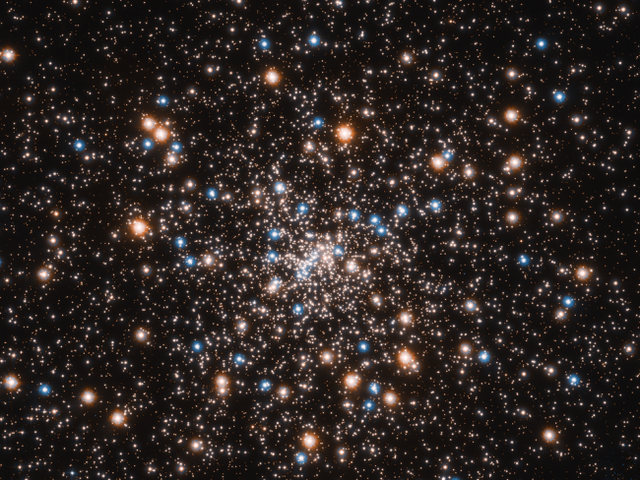
Introduction
Open star clusters, formed from the same molecular cloud, provide valuable insights into stellar evolution, galactic dynamics, and the structure of the Milky Way by sharing similar ages, chemical compositions, and kinematic properties.
Gaia's Data Release 3 (DR3) revolutionizes star cluster research with high-precision astrometric and photometric data for over 1.3 billion stars, enabling detailed analyses of cluster properties such as distances, velocities, and member compositions.
The vast size of Gaia’s dataset and measurement uncertainties pose challenges in identifying cluster members and estimating physical parameters, especially in the presence of overlapping clusters and field stars.

Slide 4
The project compares traditional clustering methods, such as K-Means, with Bayesian approaches to analyze open star clusters within Gaia’s DR3 data, focusing on computational efficiency, robustness to noise, and the ability to incorporate astrophysical prior knowledge.
Bayesian techniques, including Hierarchical Bayesian Models (HBMs) and Gaussian Processes (GPs), offer a flexible framework for modeling uncertainties and complex relationships in the data, improving the accuracy of cluster member identification and parameter estimation.
The study aims to identify the most effective clustering strategies for large astronomical datasets, contributing to a deeper understanding of the Milky Way’s stellar populations. By accurately identifying and characterizing star clusters, the project enhances models of galactic formation and evolution and provides insights applicable to other areas of astrophysics, such as star formation and chemical evolution.

Slide 5
Dataset Overview: Gaia DR3
- 1.8 billion celestial objects
- Astrometric, photometric, and spectroscopic features
- Key data: Parallax, proper motion, BP/RP photometry
- Improved accuracy and extended data over DR2

Slide 6
Methodologies
1. K-Means Clustering:
- Groups stars based on proximity using Euclidean distance.
- Iteratively optimizes cluster centroids.
2. Bayesian Gaussian Mixture Models (GMM):
- Probabilistic clustering with uncertainty handling.
- Uses the Expectation-Maximization algorithm for parameter estimation.

Slide 7
Data Preprocessing
- Parallax converted to distance using inverse relation.
- Feature selection: Right Ascension (RA), Declination (Dec), and Distance.
- Normalization ensures equal feature contribution during clustering.

Slide 8
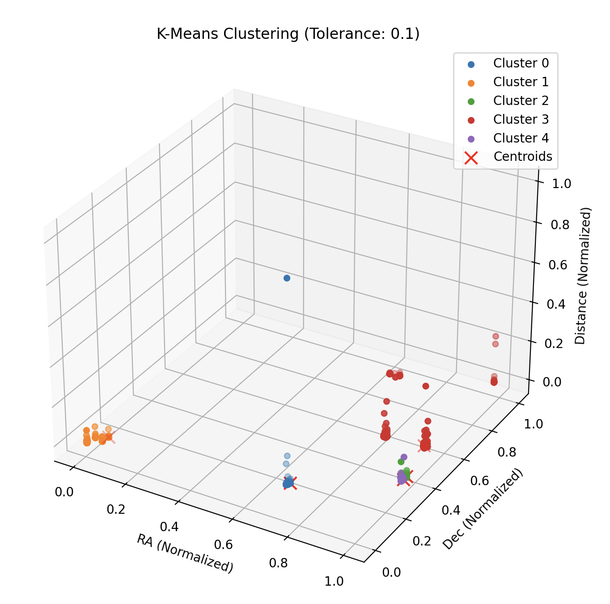
Results: K-Means Clustering
- Efficient for well-separated clusters.
- Struggles with noisy data and overlapping clusters.
- Best performance achieved with 1e-5 tolerance level.

Slide 9
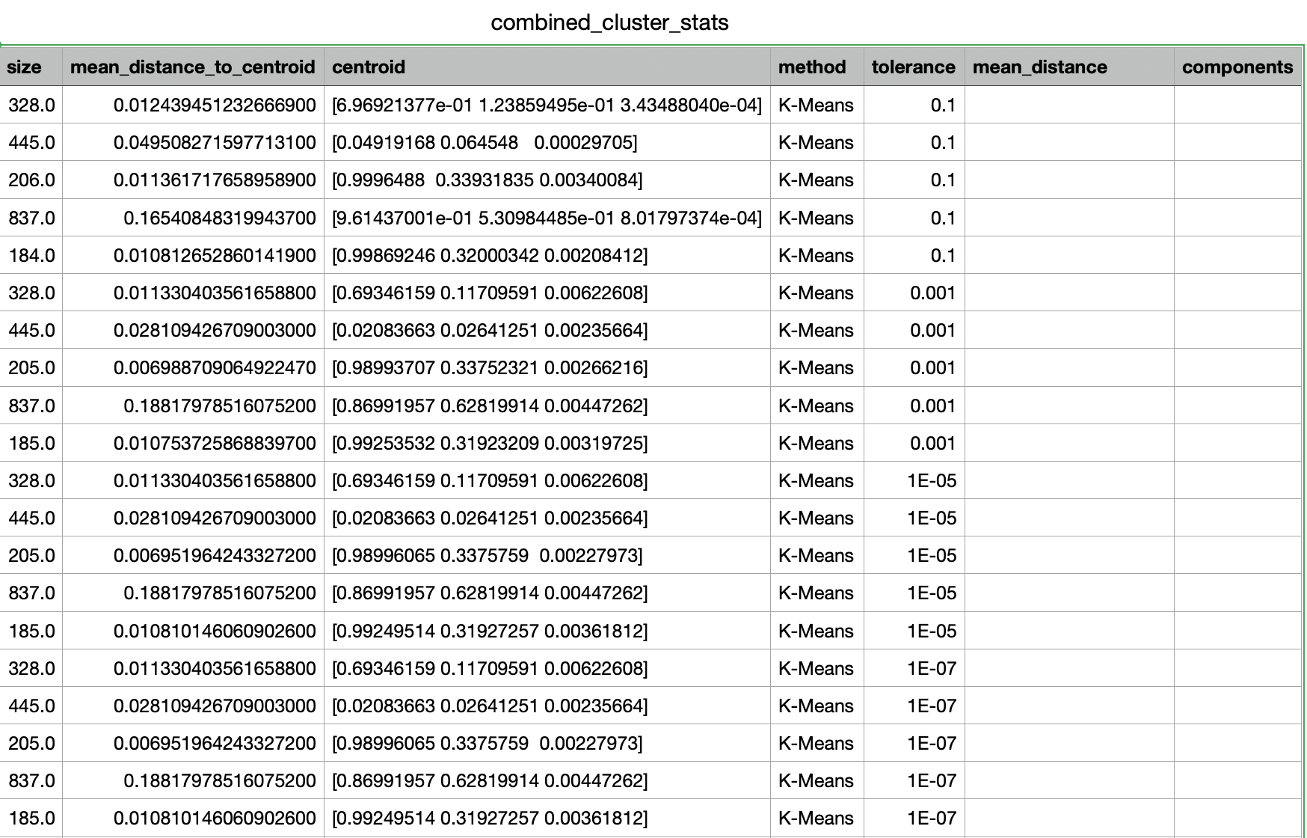
Centroid and mean distance from centroids for k-means

Slide 10
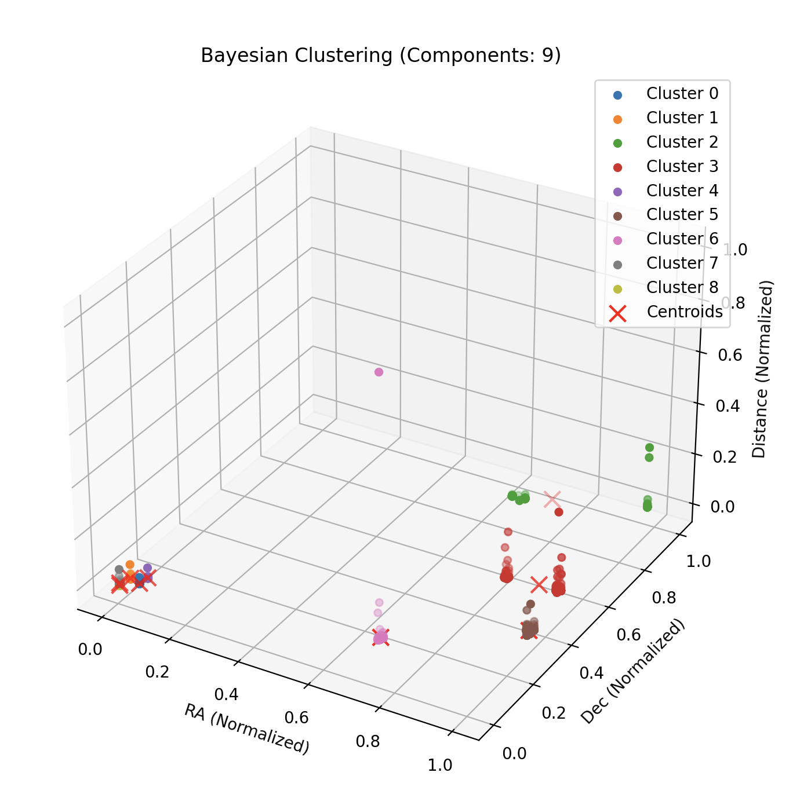
Results: Bayesian Gaussian Mixture Model
- Handles uncertainties effectively.
- Achieved highest log-likelihood with 5 components.
- More computationally intensive compared to K-Means.

Slide 11
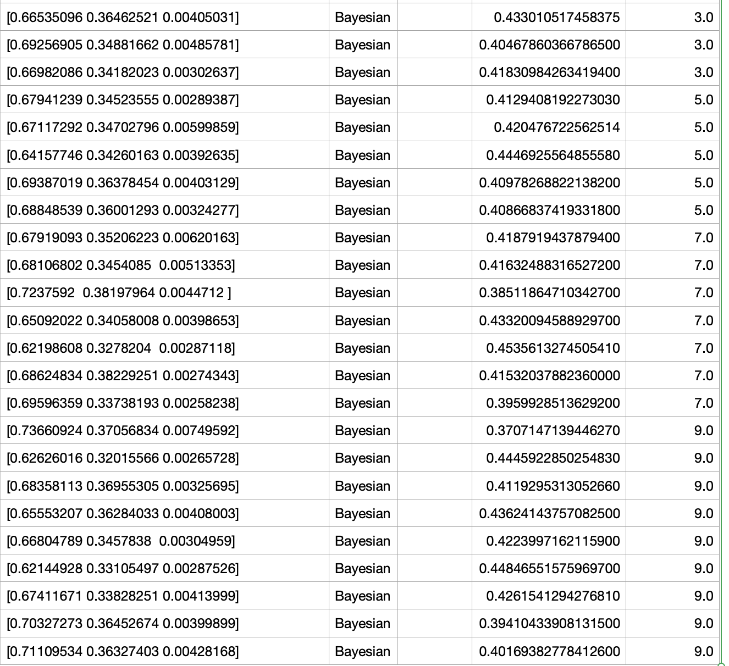
Centroid and mean distance from centroids for Bayesian

Slide 12
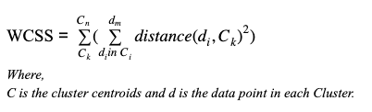
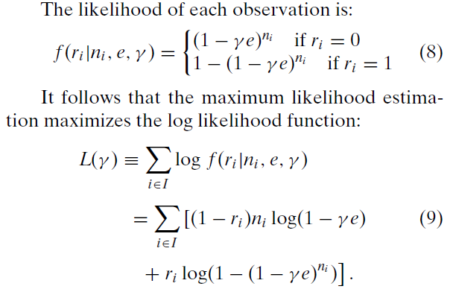
Comparative Analysis
- K-Means:
- Computationally efficient.
- Works well with simple datasets.
- Bayesian GMM:
- Robust against uncertainties.
- Effective for complex datasets but computationally demanding.

Slide 13
Output
(base) surindersinghchhabra@Mac 521 project % /opt/anaconda3/bin/python "/Users/surindersinghchhabra/Desktop/521 project/main.py"
2024-12-09 16:31:02.760 python[29009:4229924] +[IMKClient subclass]: chose IMKClient_Legacy
2024-12-09 16:31:02.760 python[29009:4229924] +[IMKInputSession subclass]: chose IMKInputSession_Legacy
K-Means clustering complete for tolerance 0.1. WCSS: 54.31338407113614
K-Means clustering complete for tolerance 0.001. WCSS: 38.316880653672946
K-Means clustering complete for tolerance 1e-05. WCSS: 38.31681661890941
K-Means clustering complete for tolerance 1e-07. WCSS: 38.31681661890941
Bayesian clustering complete for 3 components. Log-Likelihood: 9271.528747256441
Bayesian clustering complete for 5 components. Log-Likelihood: 15643.764318627638
/Users/surindersinghchhabra/Desktop/521 project/bayesian.py:42: RuntimeWarning: Degrees of freedom <= 0 for slice
cov_matrix = np.cov(cluster_points.T) + np.eye(d) * 1e-6 # Regularization term
/opt/anaconda3/lib/python3.12/site-packages/numpy/lib/function_base.py:2748: RuntimeWarning: divide by zero encountered in divide
c *= np.true_divide(1, fact)
/opt/anaconda3/lib/python3.12/site-packages/numpy/lib/function_base.py:2748: RuntimeWarning: invalid value encountered in multiply
c *= np.true_divide(1, fact)
Bayesian clustering complete for 7 components. Log-Likelihood: 18871.45219132887
Bayesian clustering complete for 9 components. Log-Likelihood: 20734.566195292766
Best K-Means configuration: Tolerance = 1e-05 with WCSS = 38.31681661890941
Best Bayesian (GMM) configuration: Components = 9 with Log-Likelihood = 20734.566195292766
Comparison of Methods:
K-Means WCSS: 38.31681661890941
Bayesian Log-Likelihood: 20734.566195292766
Bayesian (GMM) performed better for cluster identification.

Slide 14
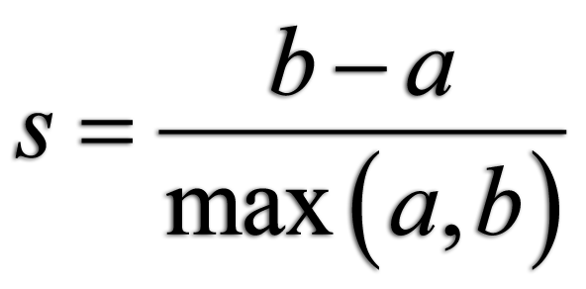
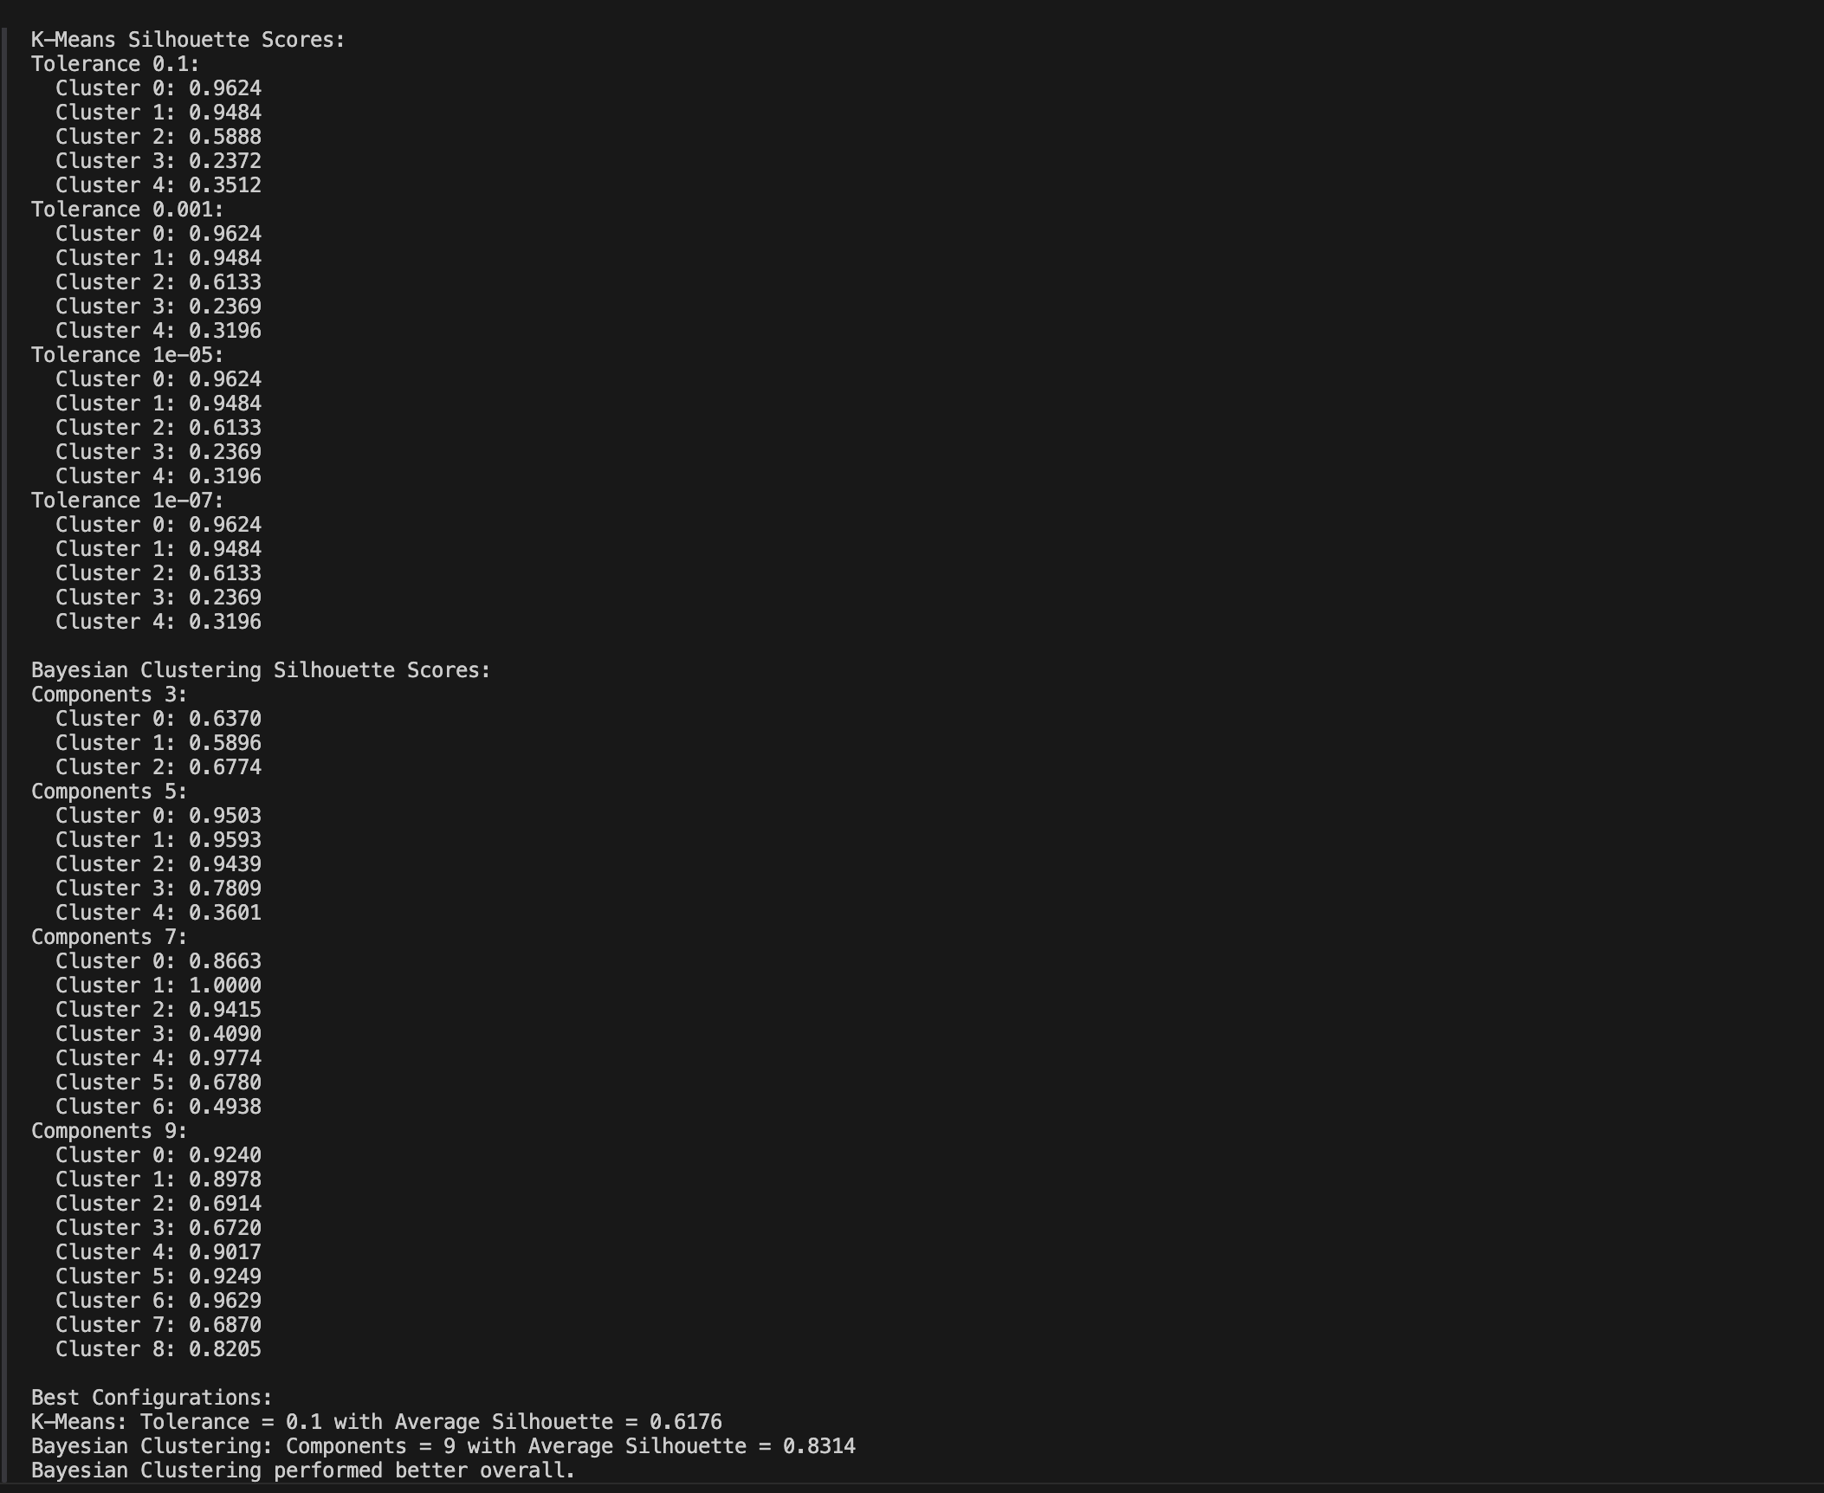
Silhouette scores
a(i): Mean intra-cluster distance.
b(i): Mean nearest-cluster distance

Slide 15
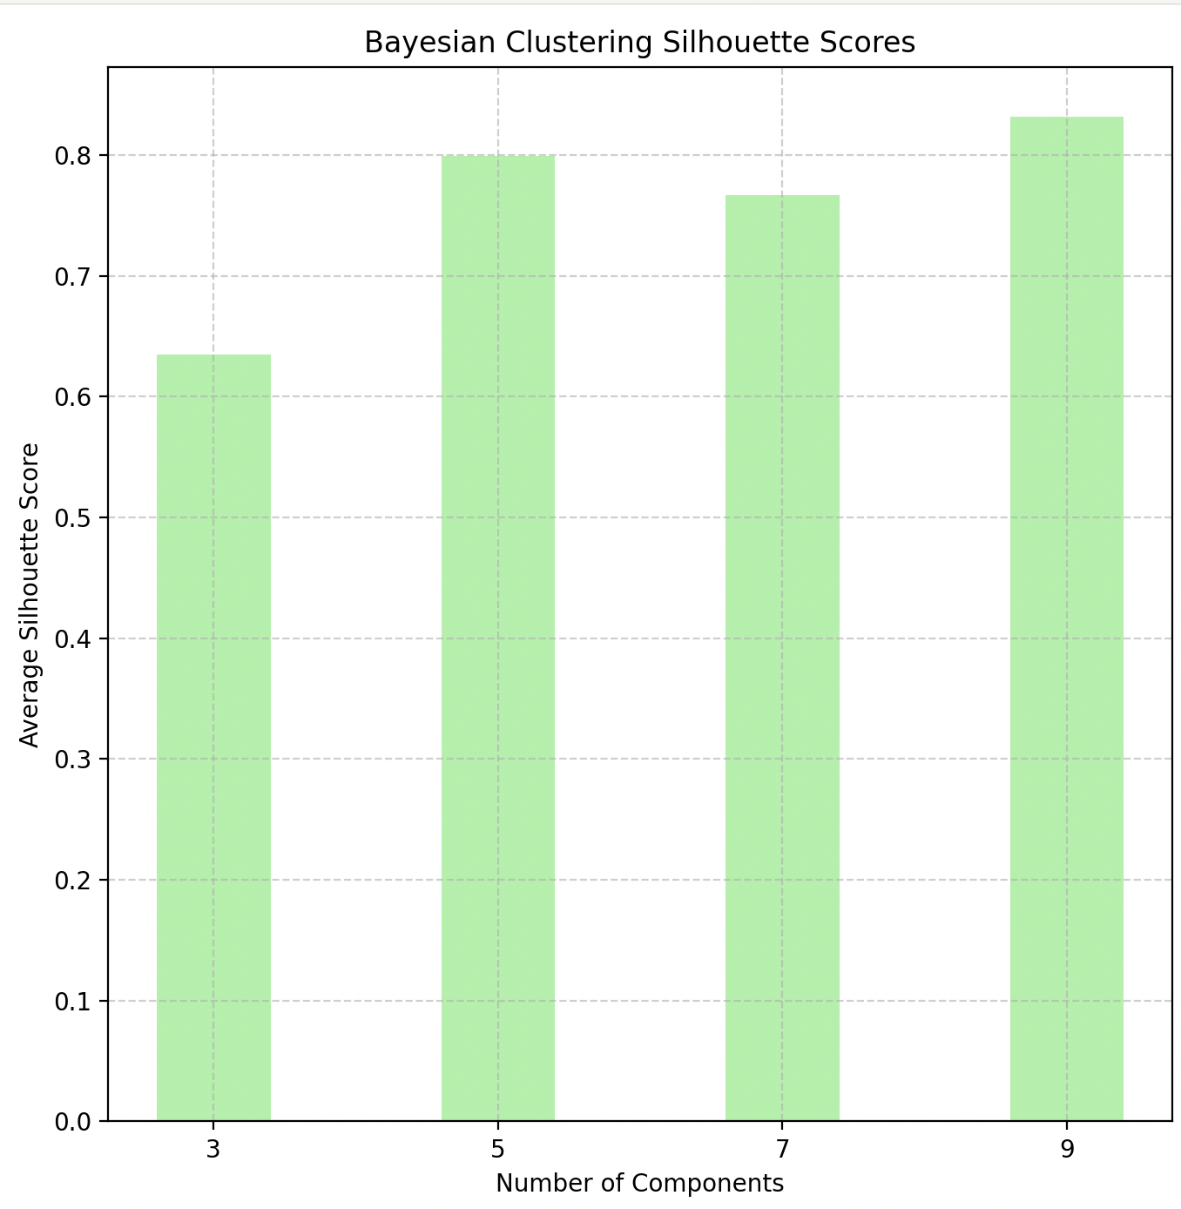
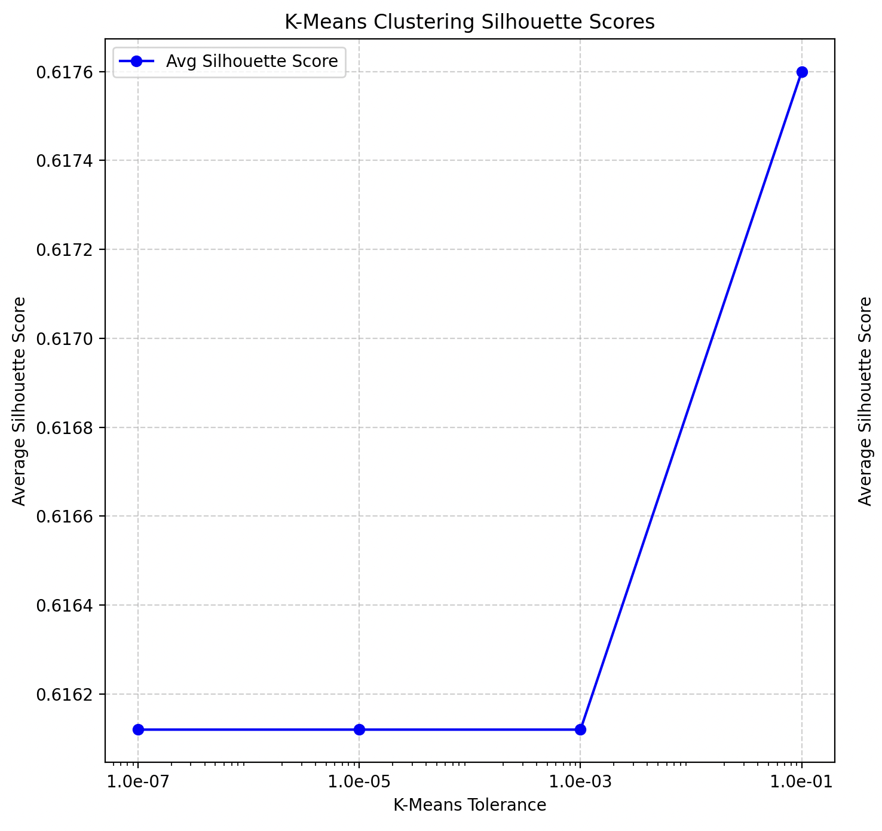
Silhouette plots

Slide 16
Key Insights
- Combining K-Means and Bayesian methods offers a balance between efficiency and robustness.
- Provides new perspectives on galactic dynamics and stellar populations.
- Demonstrates the importance of methodical flexibility in data analysis.

Slide 17
Challenges and Future Work
- Challenges:
- Scaling Bayesian methods for large datasets.
- Computational costs and parameter tuning.
- Future Directions:
- Explore Gaussian Processes for refined spatial modeling.
- Extend methods to other astrophysical phenomena.

Slide 18
Conclusion
- Compared the effectiveness of K-Means and Bayesian methods.
- Highlighted contributions to understanding the Milky Way's stellar populations.
- Advanced methodologies for astronomical clustering.

Slide 19
References
1. Gaia Collaboration et al., 2023, Astronomy Astrophysics.
2. S. Lloyd, 1982, IEEE Transactions on Information Theory.
3. Astropy Collaboration, 2013, Astronomy Astrophysics.

